Slide 1
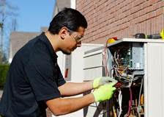
Top 10 identified & ranked barriers to HP acceleration in CO
Strong Consensus on the 1st Top Priorities
Top 2 Barriers
Buy-in of Contractor Company, Owner, and Management
Consumer Awareness

Slide 2
Top 10 identified and ranked barriers to HP acceleration
Buy-in of Contractor Company, Owner, and Management
Consumer Awareness
Marketing
Pricing Gap [field-driven]
Rebate Levels [utility-driven]
Quality Install [QI] Training [cold-climate HPs]
Leads Generation
Sales, Job Estimating, and Systems Design Equipment Availability [to contractors]
Installer QI Requirements for Certification Statewide

Slide 3
Additional top barriers identified to HP acceleration
Supply Chain Additions
Low-interest Financing [for Consumers]
Lack of Labor Available for Contractors
Cooperative Utilities and Contractor Additions
Power Supply/Electric Panel Upgrade Costs
Transformer Upgrade Costs
Rate Tariffs or Another Solution[s]

Slide 4
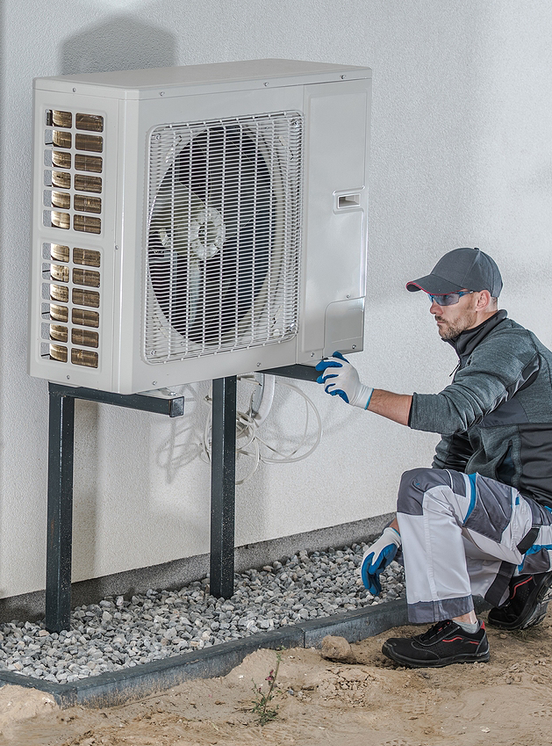
Distributors Influence Contractor Success
Most in the Supply Chain
Mobilizing the HVAC/HP Supply Chain in Colorado Through Distributors

Slide 5
Call to Action to Meet 2030
Electrification and Decarbonization Goals!
HP Supply Chain |
Construction Industry
Align HP Supply Chain and Industry Stakeholders to Achieve 2030 Milestones
CEO | Cities | State
| Non-profits |Industry Stakeholders

