Slide 1
Construction Employment Outlook
EEBC Quarterly Membership Meeting
Sept 15, 2022

Slide 2
AGC Colorado Goals
Advocacy – State, Local, Elections, PAC, Ballot Issues, Advocacy Fund, Coalitions
Membership Engagement - Committees, Education & Training, Leadership, Networking, Safety & Stormwater
Workforce Development - Apprenticeship, Adult Pre-Apprenticeship, 20 High School Construction Programs and growing www.CEFColorado.org
Culture of Care – Culture of Care Initiative at www.BuildCulture.org, Diversity & Inclusion, Mental Health & Addiction Services

Slide 3
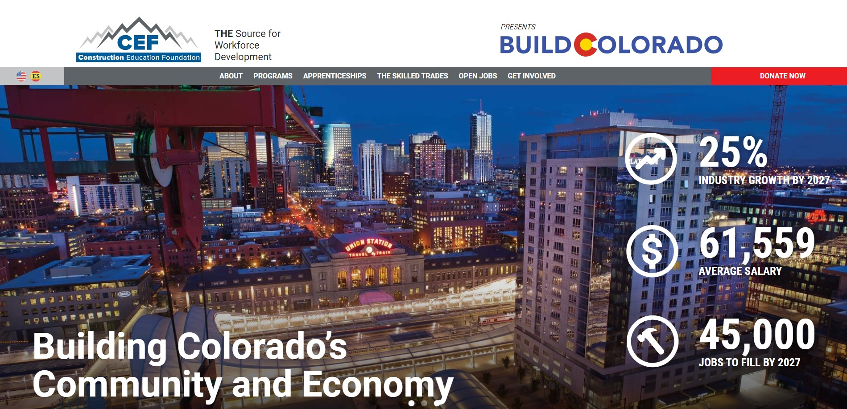

Slide 4
AGC - Construction Education Foundation Workforce Programs
Careers in Construction Colorado
Partnership with HBA
HBI Curriculum
47 High Schools
2,000 students
Construction Careers Now
Monthly adult pre-apprenticeship since 2016
1,000+ new employees versified into the industry

Slide 5
Colorado Construction Outlook
Employment Growth from 104,000 (2011) to 182,600 (Jan 2020) now again at 185,200 (July 2022)
Employment need is 220,000 in 2027 (CDLE) HUGE!!!
Commercial construction starts predicted to “Bounce along the top” for the next few years
How will industry attract employees and meet building demand?
How will industry deal with labor & materials price increases?

Slide 6
Colorado Construction Employment July 2007 to July 2022

Slide 7
Total Construction starts 2017-2022 (in Billions)

Slide 8
Residential Construction Starts 2017 to 2022 (in Billions)

Slide 9
Commercial Construction Starts 2017-2022 (in Billions)

Slide 10
Non-building Construction Starts 2017-2022 (in Billions)

Slide 11
Regional Analysis
Denver Metro Commercial Construction Starts – up 18% thru June ‘22 v ‘21
Denver Metro Residential Construction Starts – up 6% June ‘22 v. ‘21
Ft Collins Commercial Construction Starts – up 95% thru June ‘22 v. ‘21
Ft Collins Residential Construction Starts – down 11% thru June ‘22 v ’21
Colorado Springs Commercial Construction Starts – down 30% thru June ‘22 v ‘21
Colorado Springs Residential Construction Starts – down 19% thru June ‘22 v ‘21
National Commercial Construction Starts – up 22% thru July ‘22 v ‘21
National Residential Construction Starts – up 1% thru July ‘22 v ‘21

Slide 12
ABI 2010 -2022

Slide 13
ABI June 2022 57.8 in the West

Slide 14
What’s Driving Construction Growth?
Population growth - 1.5M increase in last 2 decades
Net in-migration keeps on going
Corporate relocation
Deferred infrastructure demand
Deferred housing demand

Slide 15
Colorado Net In-Migration

Slide 16
Infrastructure Funding
Local – COVID funding still around
State - SB21-260
Federal – IIJA/BIL
& IRA

Slide 17
BEST Grant Program
$110 in revenue available
$3O0M past average 2008-2021

Slide 18
2022 Advocacy Thoughts
Voter make-up 29% D, 26% R, 45% unaffiliated (breaks 2/3 D so far)
Colorado to continue to trend blue
More regulation at state & local level
More Green
More Workforce

Slide 19
Construction Outlook
Continued strong demand for residential, commercial and infrastructure
Infrastructure - Federal $1.2T plus $5.4B from SB21-260
Continued Net In-Migration
BUT
Price Increases (materials & labor) lead to LOTS of value engineering & re-estimating/pricing & developer stops & starts
Take care of team members on re-pricing
PLUS - Global recession?
Plan scenario for a possible 10-20% slowdown?

Slide 20
What’s Next
Green Building
State & local public policy
But what workforce???
Apprenticeship
State Apprenticeship Council
Apprenticeship grants
Federal focus & public policy
Construction Education Foundation
27,000 sf facility 11 classrooms & 7 labs
2 year carpentry (rough & interiors)
2 year superintendent
Sustainable Building for High School Students (module part of HBI)

Slide 21
Bottom Line
2022 Construction Employment 185,200
2027 CDLE Estimate 220,000
Gap to Close 35,000
70,000 gross?

