Slide 1
BPI Building Decarbonization Retrofit Specialist (BDRS) Certificate of Knowledge
Larry Zarker, CEO
John Jones, National Technical Director

Slide 2
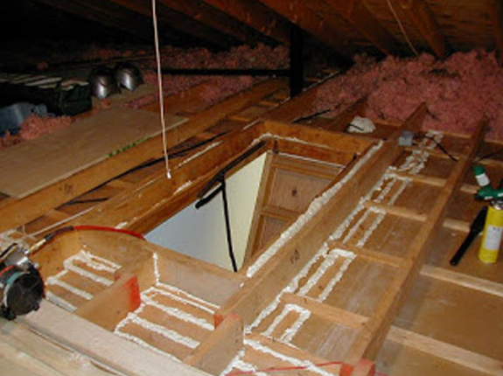
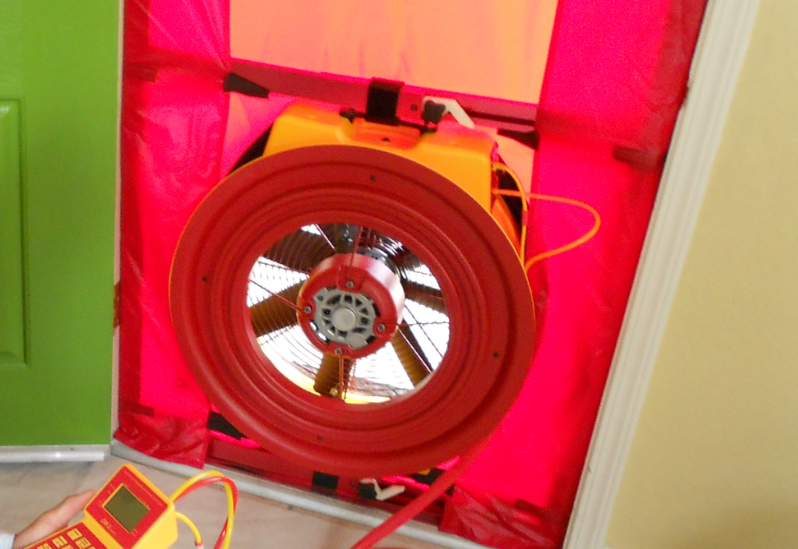
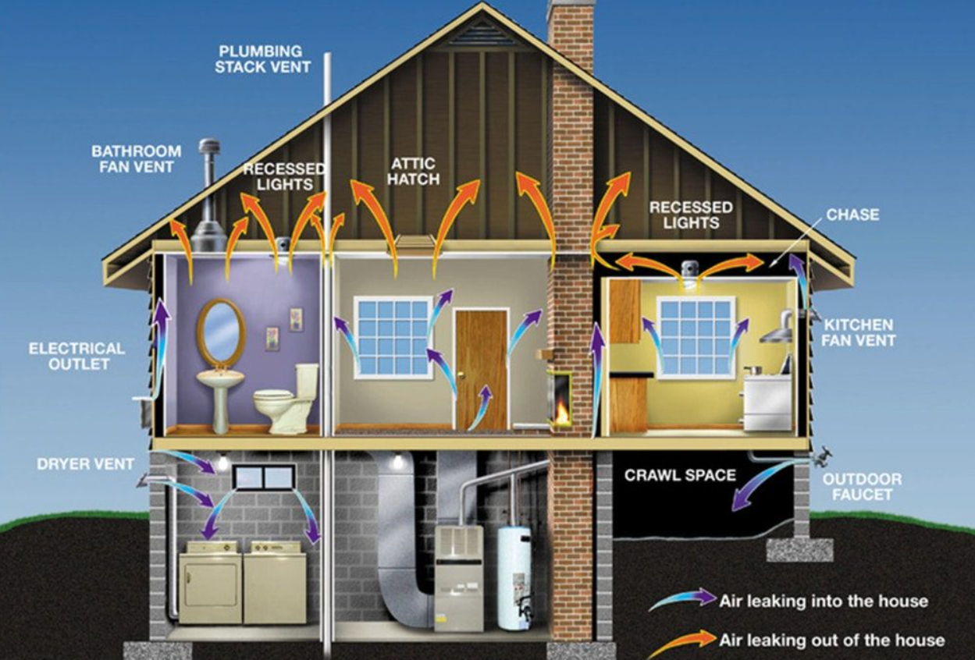
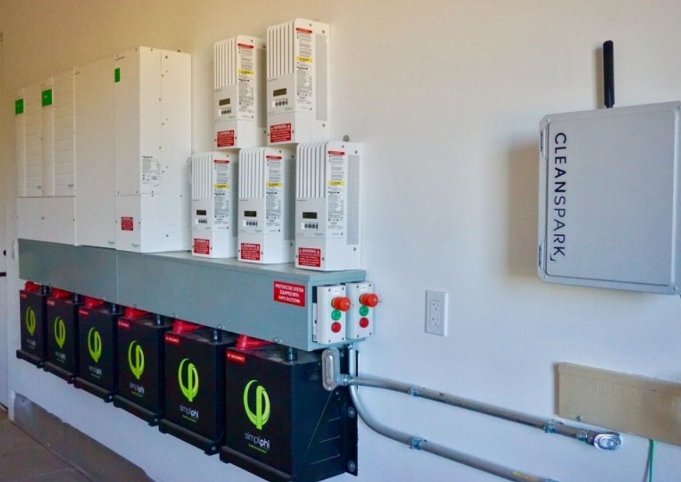
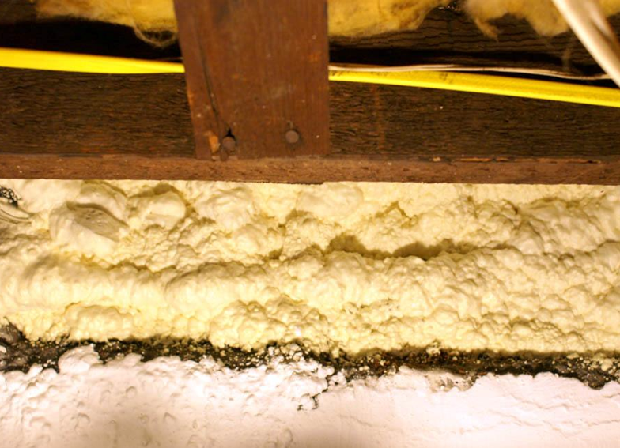
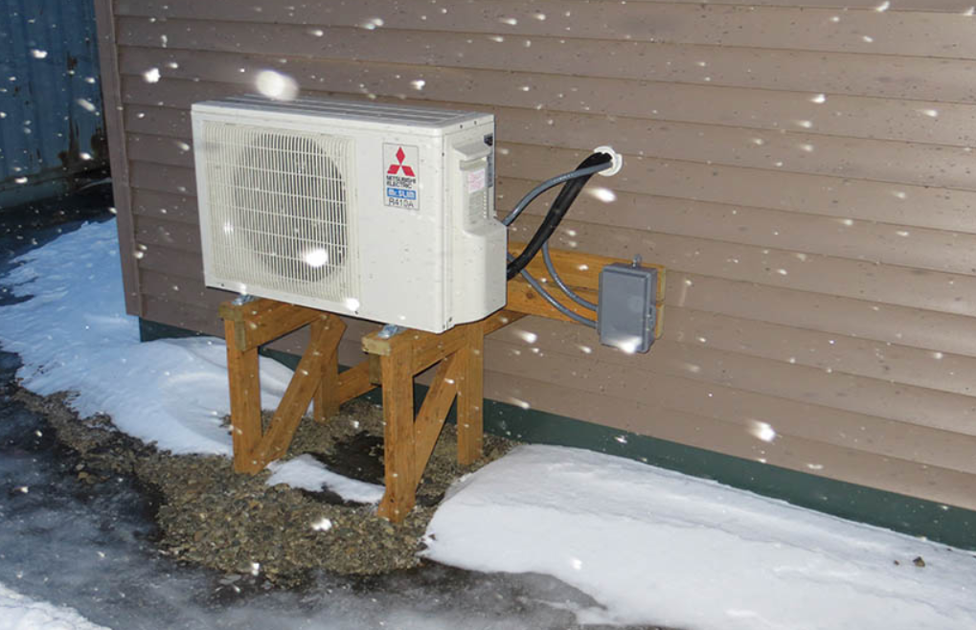

Slide 3
Scope
Building Decarbonization Retrofit Specialists (BDRS) are proficient in customer management, supporting the selection of installers, financing opportunities, and communication with customers of residential-style buildings involved in a decarbonization retrofit project. They are responsible for identifying the optimization and sequence of potential deep energy retrofit projects and recruiting building owners to pursue the goal of net zero energy consumption and/or net zero carbon of the building.

Slide 4
Scope (cont’d)
BDRS have an awareness and understanding of state, local and utility energy efficiency and renewable energy programs. BDRS are responsible for scope of work development and understanding the interdependencies of proposed measures and systems involved. They have an understanding of the energy, cost, and carbon impacts of the proposed measures. The BDRS is responsible for project completion verification to project design, test-out, and any close-out report generation. BDRS are responsible for a commissioning review of the project performance post completion. BDRS have a general understanding of the fundamentals of building science.

Slide 5
Responsibilities

Slide 6
Discussions? Questions? Ideas?
Building Performance Institute, Inc. (BPI)
www.BPI.org
Larry Zarker, CEO
lzarker@bpi.org
(202) 256-3893 direct
John Jones, National Technical Director
jjones@bpi.org
(518) 899-2727 ext. 117 (office)

