Slide 1
September 15, 2022 Quarterly Member Meeting PUC Update
PSCo DSM/BE Strategic Issues
and 2023 DSM & BE Plan Filings
Mark Detsky & K.C. Cunilio
Dietze and Davis P.C.
EEBC Counsel
Howard Geller, EEBC Consultant

Slide 2
Two Big Dockets in 2023
Public Service Company of Colorado
“Strategic Issues” - 22A-0309EG
“2023 DSM Plan” – 22A-0315EG
Currently pending motion to extend current DSM Plan.
Strategic Issues sets up future DSM/BE program plans which are expected to cover: (a) 2024-25 and (b) 2026-27.

Slide 3
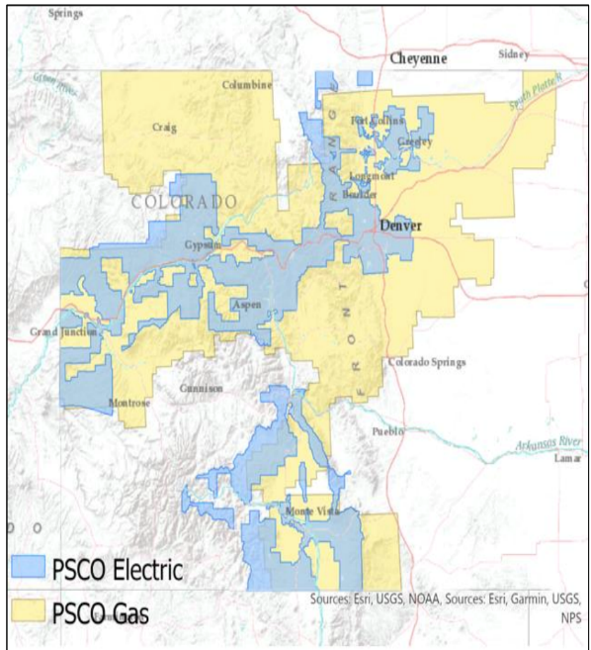
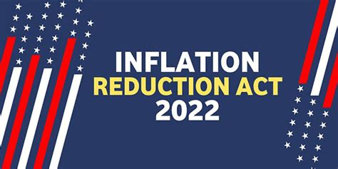
Fifth ‘Strategic Issues’ Proceeding
Define: Energy Savings goals (electricity and natural gas); Budget caps; Utility incentives
Time period: 2024 through 2027
Context: New legislative requirements; rapidly changing electricity supply mix
Beneficial Electrification goals (first time), and establish policies on issues such as BE program cost recovery
Notes:
En banc
In Senate Bill 21-246, the Legislature specifically provided that Beneficial
7 Electrification strategic issues filings “may be combined with other demand-side
8 management strategic issues or related filings as appropriate.
the law revised the definition of BE,
13 required utilities to file BE Plans at least every three years, and set forth minimum
14 requirements for BE Plans by 4/24
House Bill 21-1238 updates the methods used to determine the cost-effectiveness
6 of gas DSM programs, including with respect to the social costs of greenhouse gas
7 emissions. The law also required gas strategic issues filings, like this one, and
8 addresses cost recovery and incentives for gas DSM. The Commission is
9 currently engaged in a rulemaking process covering both House Bill 21-1238 and
10 Senate Bill 21-264 (and other related matters) in Proceeding No. 21R-0449G.
11 Q.
This will be the fifth proceeding where the Commission, the Company, and interested parties have opportunity to examine the larger policy issues that will help shape the Company’s next DSM Plan. Public Service states, however, this Strategic Issues proceeding will differ from prior cases because it also includes BE.
Shift from previous cases with the addition of BE, a greater focus on gas DSM, more focused efforts to reduce carbon emissions, and changing needs of electric DSM.

Slide 4
PSCo Strategic Issues Possible Schedule & Key Steps
Filed July 1. Schedule should be finalized in the next week. Decision by May 1, 2023.
IRA-related Supplemental Direct Testimony.
Answer Testimony from EEBC other Intervenors sometime in November 2022.
Likely a fully-litigated proceeding with a multi-day evidentiary hearing in Q1 of 2023.
To be heard and decidedby full PUC
Notes:
Answer Testimony refers to ‘Answering’ the Company’s prefiled testimony about goals, budgets, policies

Slide 5
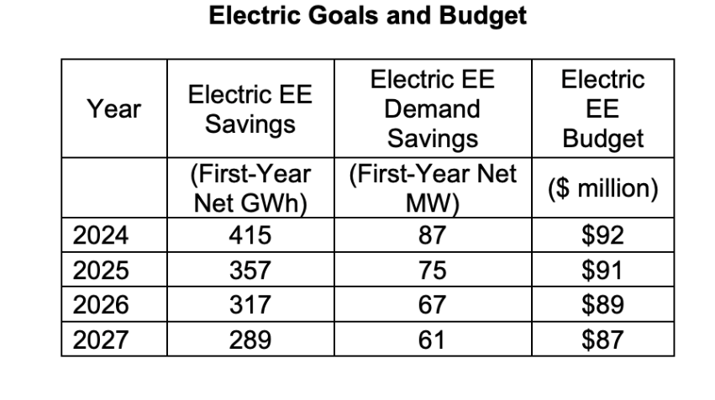
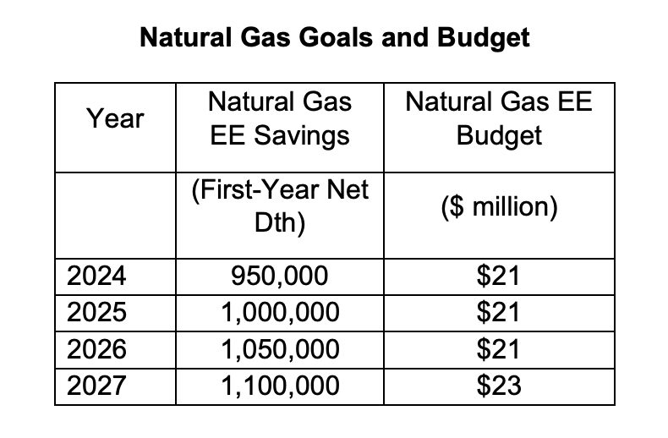
PSCo Strategic Issues Budget/Goals
Demand Response Goals
Notes:
“Crucially, although electric EE
17 programs will continue to be important, their relative role in the overall DSM
18 portfolio of programs is expected to diminish to some extent. As the Company’s
19 generation has become less carbon-intensive and more sourced from renewable
20 energy, the de-carbonization and fuel-savings benefits of electric EE have
21 decreased while the costs of such programs have increased.”

Slide 6
Key Issues
Are declining electricity savings goals reasonable?
Is the shift away from electric savings and towards expanded gas EE and BE-related savings reasonable?
Are the BE targets and budgets big enough?
Is the Company “low-balling” goals in general, as it has done in the past? Should the goals by higher in light of substantial new Federal incentives via the IRA?
Is the new approach to determining program cost effectiveness and priorities reasonable?
Is the new, more complex and potentially more generous shareholder incentive mechanism reasonable?
Is the proposed new approach and increased emphasis on serving income-qualified households reasonable?
Notes:
a nutshell, the Company is
18 proposing to place heightened emphasis on which energy is being saved, relative
19 to the total number of kWh, kW, or therms saved.

Slide 7
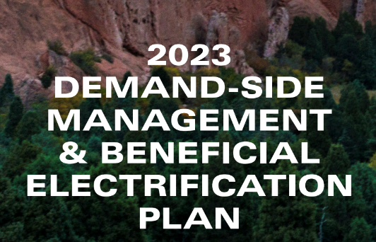
PSCo 2023 DSM & BE Plan Proceeding
Only a one-year plan (combined electric and natural gas) building on the current 2021-22 plan
To be heard and decided by PUC as a whole
Four Segments of Plan: Executive Summary; Program & Product Summaries; Cost-Benefit Analysis; Appendices
Notes:
En banc
520 page plan; KC and Patricia have segments of the Plan available depending on industry or topic for members to review
Inaugural BE Plan (new requirement). Black Hills also filed a standalone BE plan.
Company further notes that SB 21-246 established a number of new labor standards with respect to its BE offerings. Notably, the bill applies to “all necessary mechanical, plumbing, and electrical work performed in connection with a project undertaken pursuant to a beneficial electrification program … and for which a customer of an investor-owned electric utility applies for a rebate directly from the utility.” The statute allows utility employees to conduct the list, and also directs the Company to publish a Certified Contractor List. Public Service is aware of these provisions and will implement them as appropriate.
Commssion notes that the “IRA modifies and extends tax credits related to renewables, geothermal, energy efficiency home credits, and energy storage, as well as rebates energy efficiency products, and home and commercial electrification products and appliances. The Commission recognizes that this is a one-year DSM/BE Plan that coincides with the introduction of substantial federal incentives and tax credits.”
The Company should identify potential changes to its cost-benefit analysis for programs that may be impacted by incentives (both upfront as well as tax credits) in place beginning in 2023.
What impacts will the IRA's incentives have on the Company meeting its stated energy and demand savings forecasts and how will the proposed performance incentives be impacted with greater non-utility funding available to customers?
For each of the incentives listed in Hearing Exhibit 201, pg. 21, please identify the corresponding federal incentive available in 2023, along with any income restrictions
Please identify the potential impacts of the IRA on the Company's proposed DSM/BE Income Qualified and Disproportionately Impacted programs, particularly focused on weatherization, and whole home energy audits

Slide 8
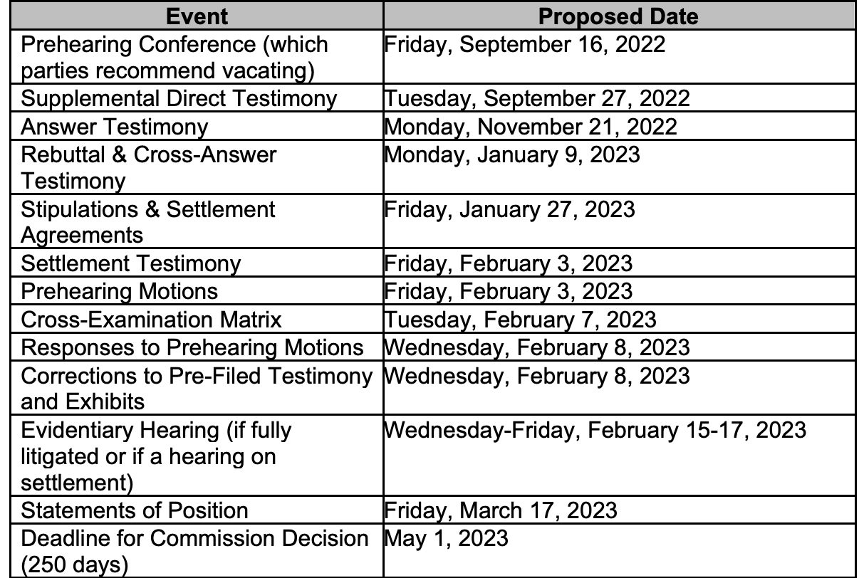
PSCo 2023 Plan Schedule & Key Steps
PSCo Supplemental Direct on IRA due late September
Settlement negotiations
DSM Plans traditionally result in settlement agreements rather than litigated hearings
EEBC will put together a package of proposals for other parties to consider
Intervenor Answer Testimony late November
Rebuttal & Cross-Answer early January
Notes:
Not yet approved by the Commission (TBD on CWM day before this prezzy)

Slide 9
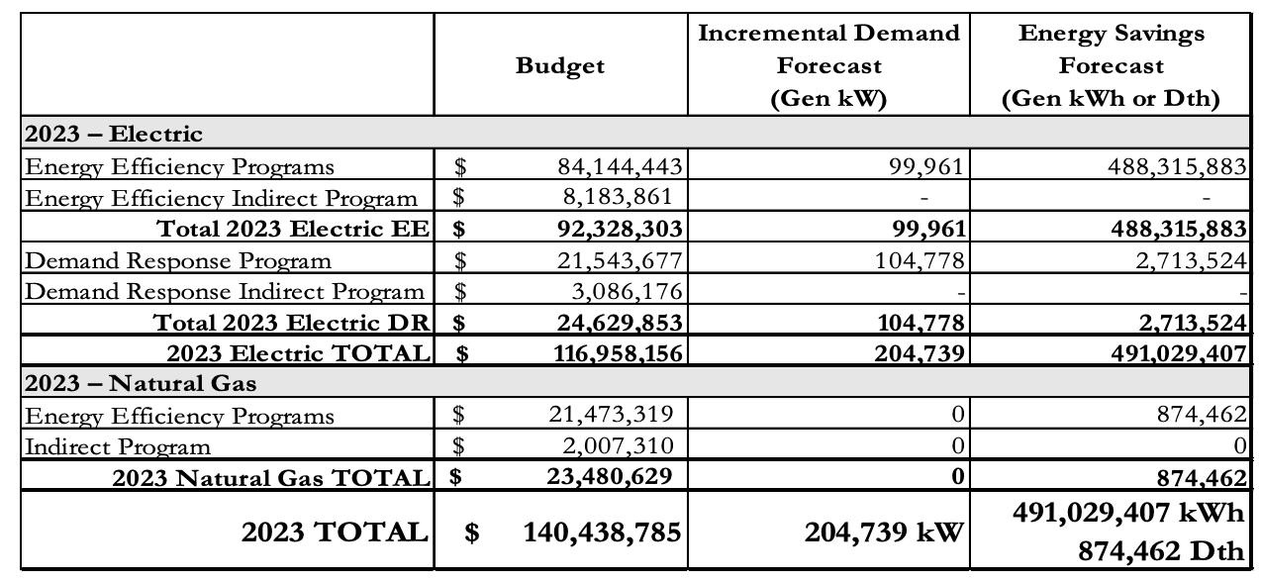
PSCo 2023 Plan Budget/Goals
Notes:
Program: a collection of similar products targeted to a specific customer
14 segment. Current programs in the Company’s DSM Plan include Business,
15 Residential, Low-Income/Income-Qualified (“IQ”), and Indirect programs.
16 • Products and Pilots: a collection of similar measures marketed individually
17 or holistically to end-use residential, business, or IQ customers. Pilots
18 target a specific type of product, and often seek to evaluate and
19 demonstrate the benefits of a measure or collection of measures for a
20 period prior to full-scale deployment.
21 • Measure: a technology, service, or device that enables end-use customers
22 to modify their total energy consumption and peak demands. Examples
23 include water-heater blankets within the Home Energy Squad product and
24 ground source heat pumps within the High Efficiency Air Conditioning
25 product.

Slide 10
Key Issues
Can electric efficiency programs be enhanced so that the plan achieves at least 500 GWh/yr of savings (the target based on the previous SI docket order)?
Are the BE participation targets robust enough, taking into consideration the new IRA incentives?
Should the Company continue a mass market LED lamp buydown program in 2023, considering market conditions and new federal standards?
Should the Company do more in the area of demand response in light of the ongoing shift to smart meters and TOU rates?
Are their more opportunities for midstream incentives and supply chain engagement?
Notes:
a nutshell, the Company is
18 proposing to place heightened emphasis on which energy is being saved, relative
19 to the total number of kWh, kW, or therms saved.

Slide 11
Questions?
Mark Detsky
mdetsky@dietzedavis.com
K.C. Cunilio
kcunilio@dietzedavis.com
Howard Geller
hgeller9@gmail.com

